Slide 1
Classification of brain tumor types in histopathology images with deep learning
Midterm presentation
Dávid Hrabovszki

Slide 2
The aim is to classify two different types of brain tumor from Whole Slide histology images using Deep Learning.
Supervisor: Anders Eklund
Additional supervisor / customer: Neda Haj Hosseini
Department: Biomedical Engineering (IMT), US Campus

Slide 3
Background
Pathology: branch of medical science primarily concerning the cause, origin and nature of disease
Histology: branch of biology which studies the microscopic anatomy of biological tissues
Whole Slide Images (WSI): digitized tissue slides under a microscope
Brain tumor grades according to WHO increase in malignancy:
I
II
III
IV
Binary classification (expert task, that can be helped with DL)
Lower Grade Glioma (LGG)
Glioblastoma Multiforme (GBM)

Slide 4
Data
The Cancer Genome Atlas (TCGA) https://portal.gdc.cancer.gov
1704 Whole Slide Images, on average 800 MB each
e.g. 100,000 x 50,000 pixels
Some WSIs are excluded (out of focus, pen marker, cannot fit into memory)
2 classes: GBM (860 WSIs) – LGG (844 WSIs)
100 WSIs sampled for analysis (to lower processing time)
Images need to be divided into patches to feed to CNN
WSIs are labeled per image -> no labels at pixel / patch level

Slide 5
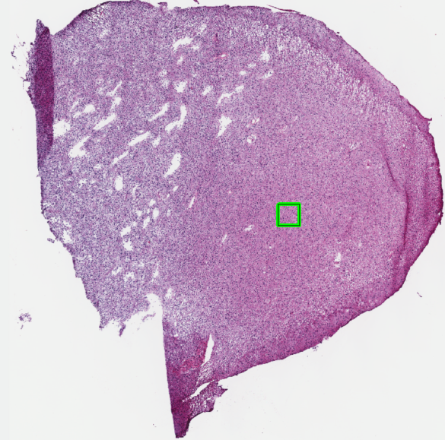
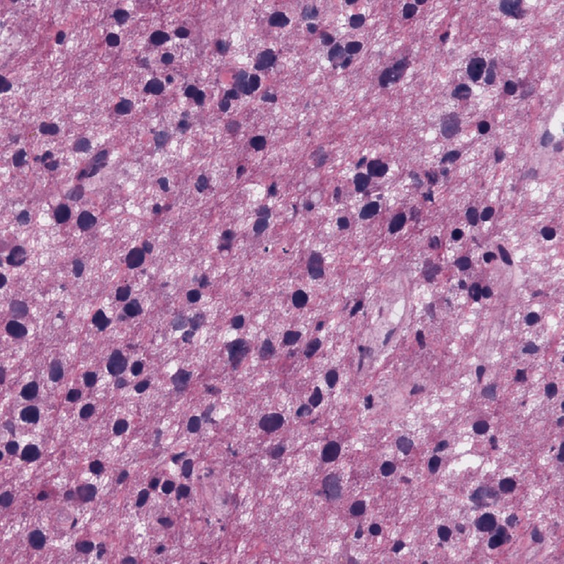
Example – Whole Slide Image (LGG class)
Patch extraction

Slide 6
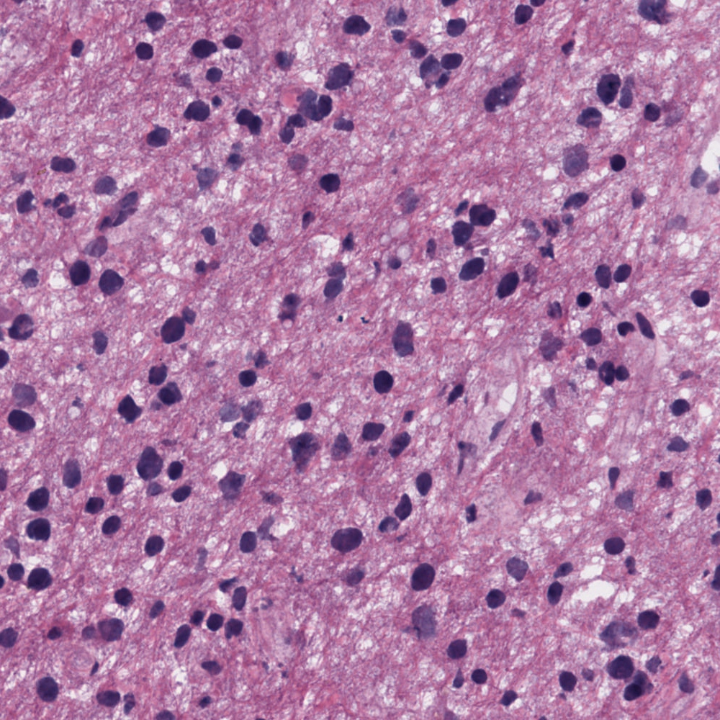
Example – One patch with visible cells and structures at 20x magnification (LGG class)

Slide 7
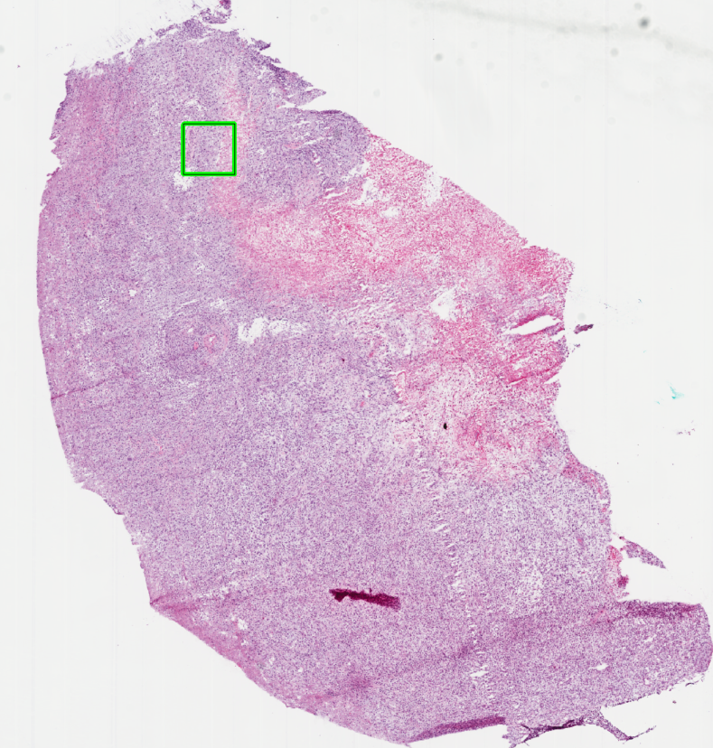
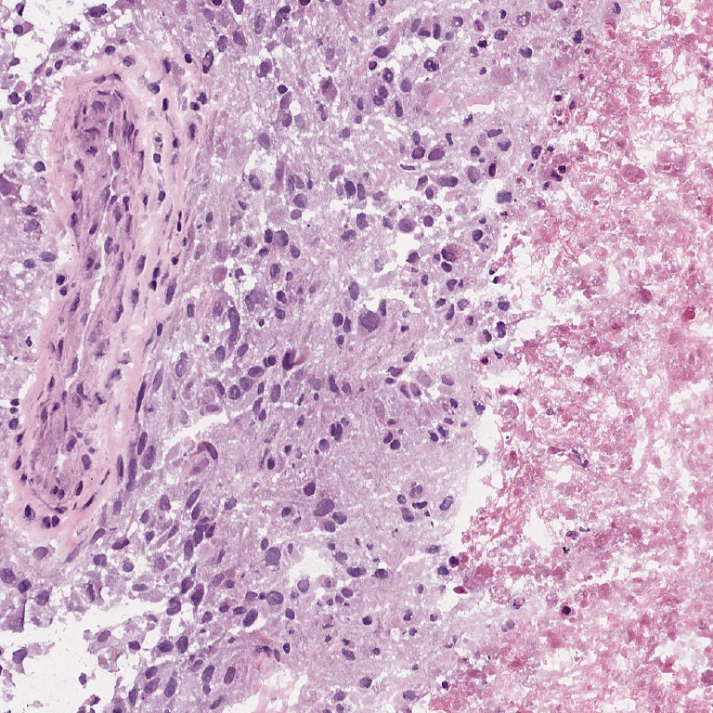
Example – Whole Slide Image (GBM class)
Patch extraction

Slide 8

Example – One patch with visible cells and structures at 20x magnification (GBM class)

Slide 9
Research question
What is the best approach with Deep Learning for GBM vs LGG classification using histology images without pixel level annotation?
Challenges:
No pixel level labeling (patches in a slide might be cancer-free or belong to the other class)
Large images (need to create patches)
Slides come from different sources -> need to be normalized
Find the best solution by comparing evaluation metrics statistically:
Accuracy, Precision, Recall, F-score
AUC, ROC curve

Slide 10
Progress so far
Familiarizing with the dataset
Identified data quality problems: pen markings, blurry images
Not all WSIs fit into 64 GB memory
Preprocessing
Downscaled 40x magnification images to 20x
Filtered out white background on thumbnail version of images (faster)
Extracted patches in 2 sizes: (336 x 336), (672 x 672), that contain > 95% tissue
Normalized patches (computationally very expensive: took 4 days on 3 computers in parallel)
Considered multiple stain (color) normalization methods, chose Vahadane
Vahadane method = finds the two basis stain colors (pink and purple variants) that best fit the target image, then casts them onto the image to be normalized (Vahadane et al., 2016)

Slide 11
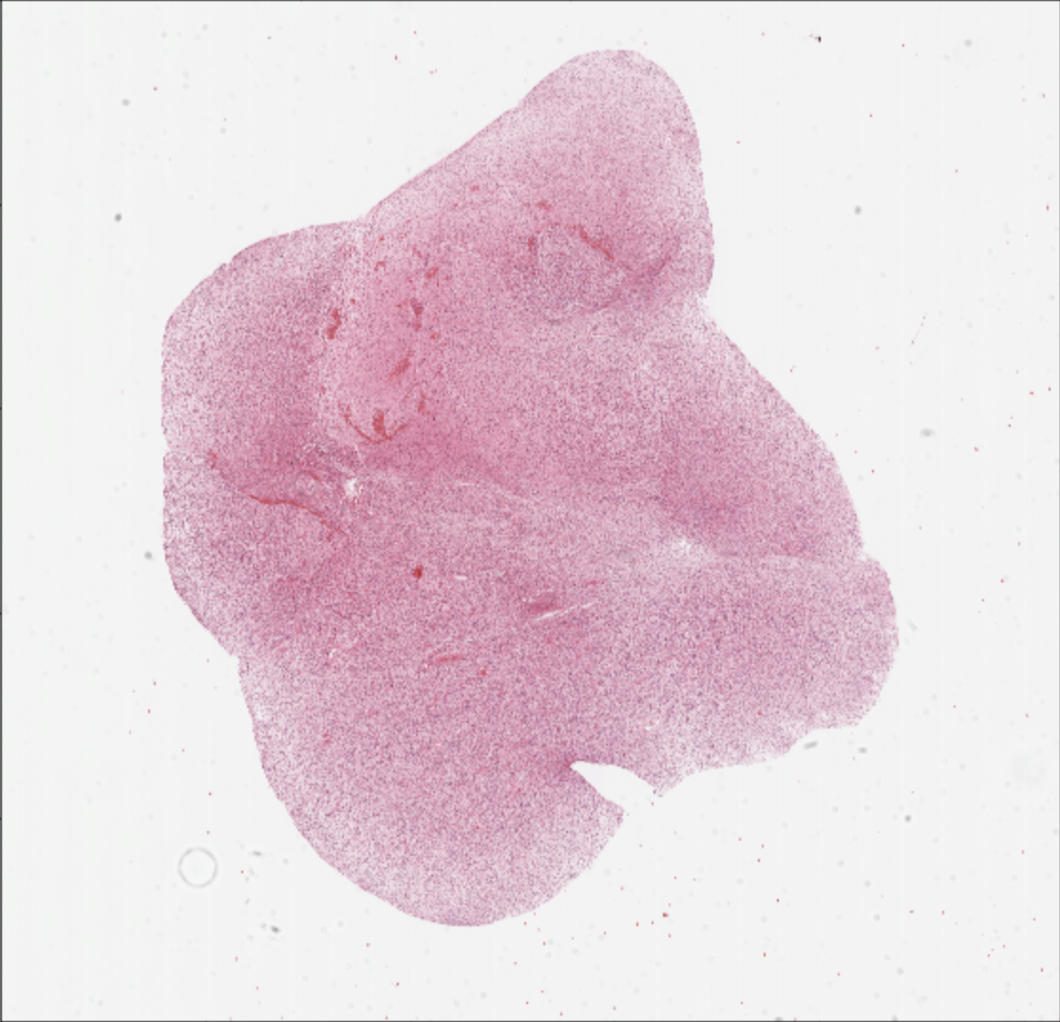
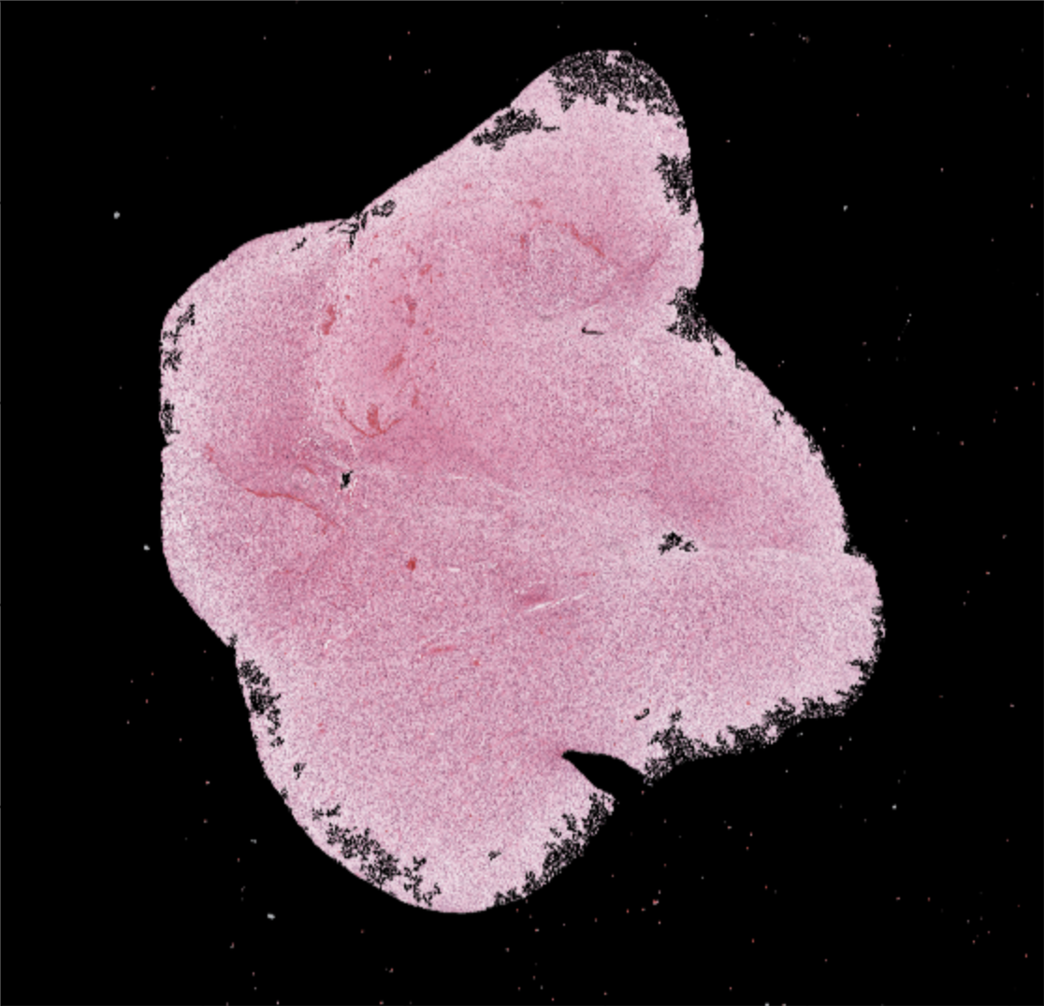
Background filtering and patching
original
background filtering + patching

Slide 12
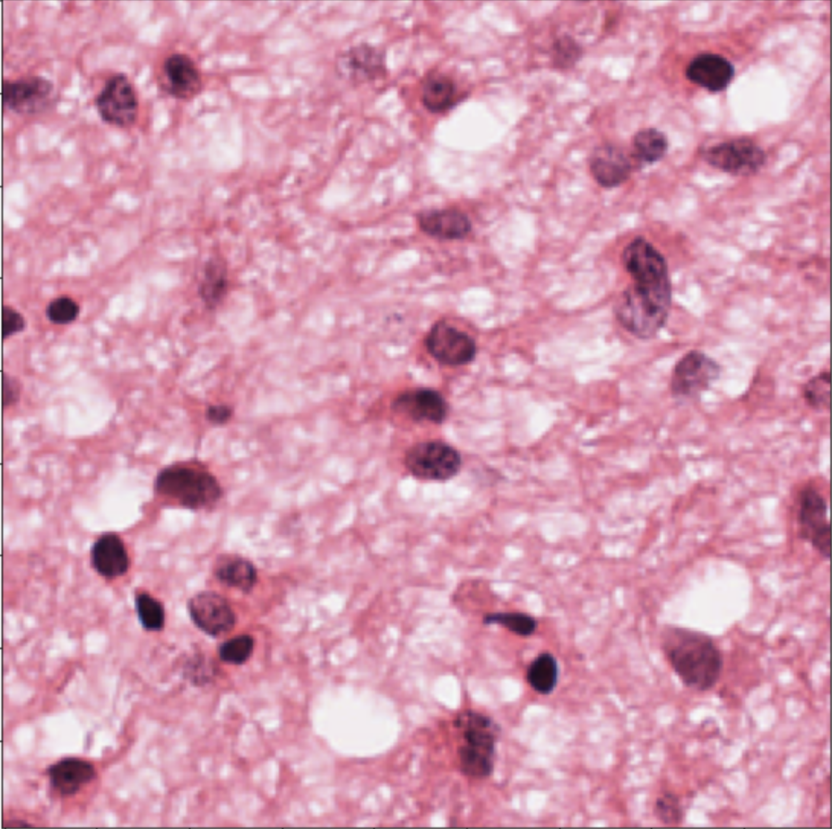
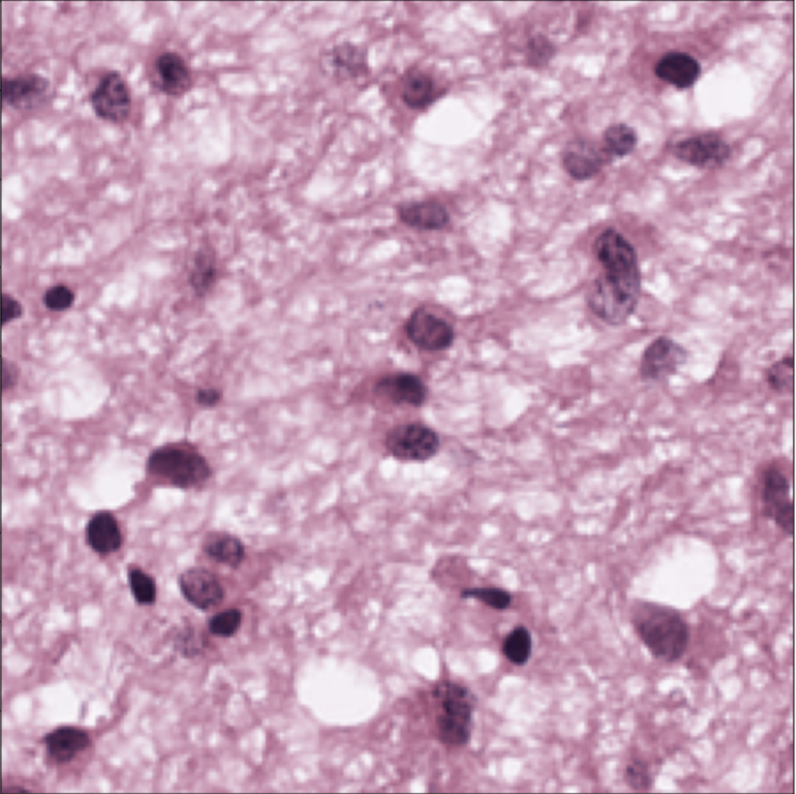
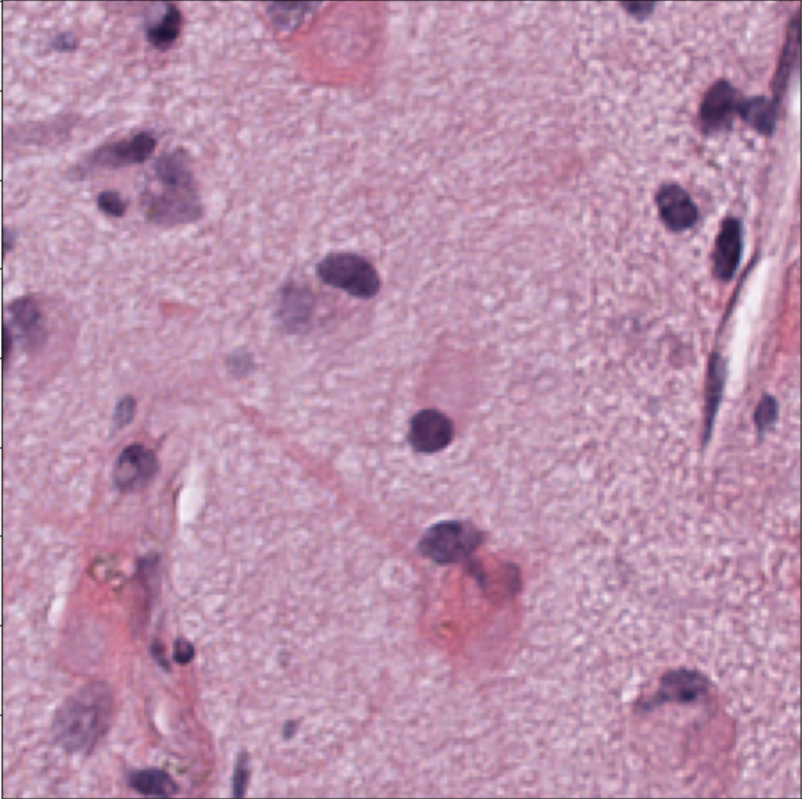
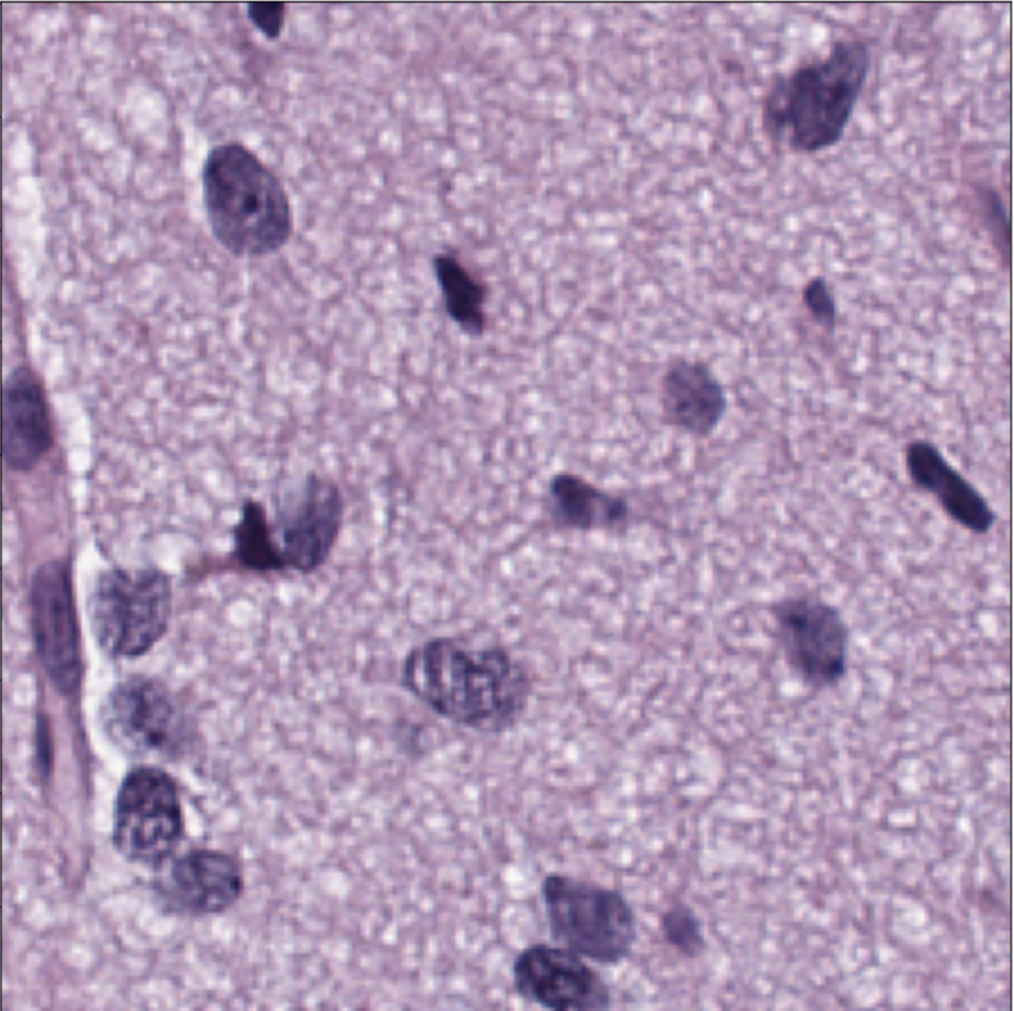
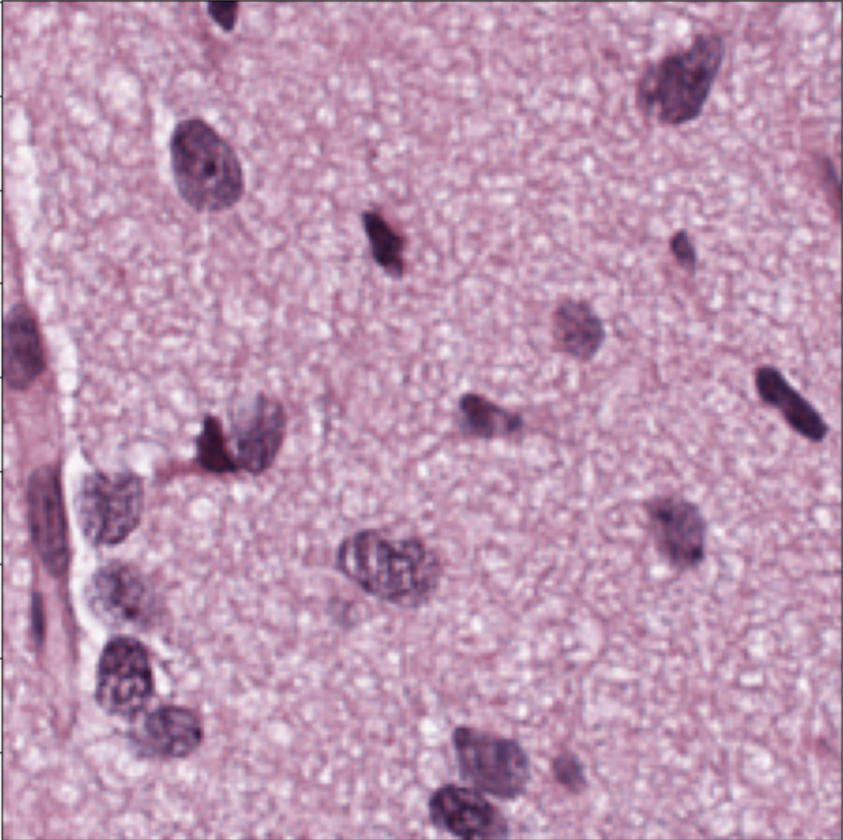
Patch normalization (Vahadane method)
target
original
normalized

Slide 13
Preprocessed dataset (number of patches)
Class \ patch size | 336 x 336 | 672 x 672
GBM | 204,674 | 46,417
LGG | 163,844 | 37,394
Total | 368,518 | 83,811

Slide 14
Next steps
Train CNN model on patches
Use pretrained network (probably ResNet)
Add Dropout and fully connected layer at the end
Monte Carlo Dropout for uncertainty estimates
Implement 5 techniques for aggregating predictions to slide level
Main challenge of this thesis
Details on next slides
Compare performance of 10 different approaches statistically (2 patch sizes x 5 aggregation methods)
Confusion matrix metrics
pROC library in R
Finish report

Slide 15
Methods for combining patch predictions to slide level (1/2)
Baseline method: simple majority voting
Not how pathologists make decisions
Uncertainty is ignored
Prediction is the ”average” of MC Dropout simulations
Logistic regression with features from CNN patch predictions
Features of logreg: # GBM > 90% certainty, # LGG > 90% certainty, # GBM > 80% certainty, # LGG > 80% certainty, # GBM > 70% certainty, # LGG > 70% certainty, …
Flipping uncertain patches based on spatial location + majority voting
GBM (certain) | GBM (certain) | GBM (certain)
GBM (certain) | LGG (UNCERTAIN) | GBM (certain)
GBM (certain) | GBM (certain) | GBM (certain)
GBM | GBM | GBM
GBM | GBM | GBM
GBM | GBM | GBM

Slide 16
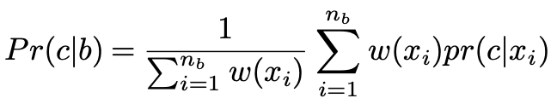
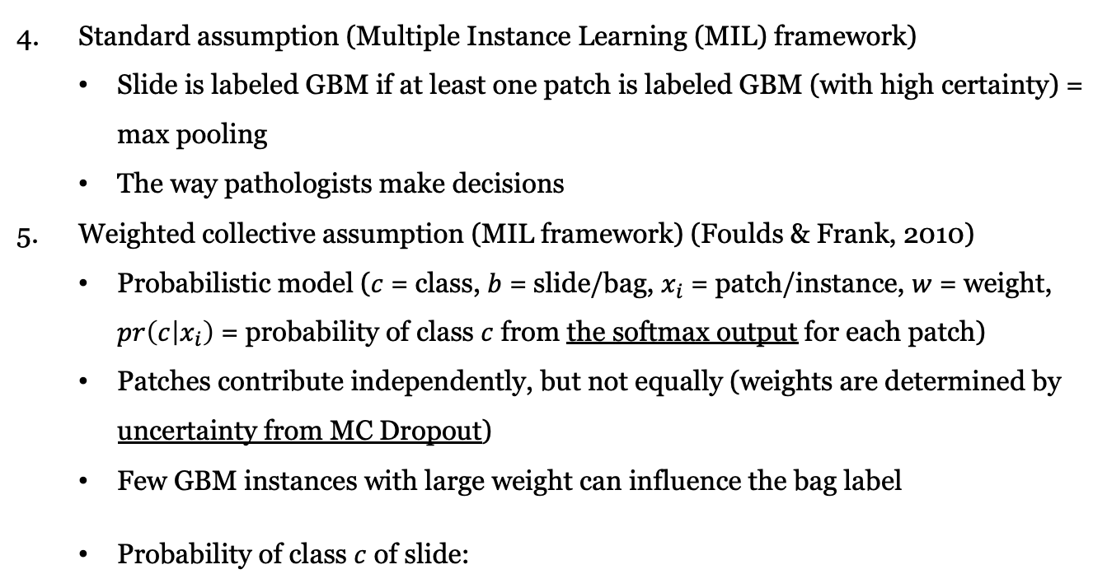
Methods for combining patch predictions to slide level (2/2)
Standard assumption (Multiple Instance Learning (MIL) framework)
Slide is labeled GBM if at least one patch is labeled GBM (with high certainty) = max pooling
The way pathologists make decisions
Weighted collective assumption (MIL framework) (Foulds & Frank, 2010)
Probabilistic model ($c$ = class, $b$ = slide/bag, $x_{i}$ = patch/instance, $w$ = weight, $pr\left(c | x_{i}\right)$ = probability of class $c$ from the softmax output for each patch)
Patches contribute independently, but not equally (weights are determined by uncertainty from MC Dropout)
Few GBM instances with large weight can influence the bag label
Probability of class $c$ of slide:

Slide 17
Report outline
Introduction: challenges, medical and statistical background
Related work
Data: data description
Methods:
Preprocessing
CNN modelling
Monte Carlo Dropout
WSI level prediction aggregating techniques
Results: statistically compare approaches using evaluation metrics
Discussion
Conclusion

Slide 18
Thank you!

